Slide 1
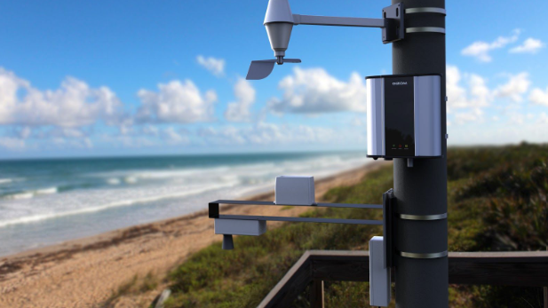
Weather Monitoring System Power Supply Subsystem
Tony Leggiero
Steven Vele
Binh Ho
Michael Rabanales

Slide 2

Abstract
The New York State Department of Environmental Conservation is implementing a distributed weather network statewide to better comprehend climate change's impact on microclimates
The network will enable real-time monitoring, in-depth analysis, and predictive modeling, empowering policymakers, and stakeholders with valuable information for proactive climate adaptation
Through collaboration, this project strives to support sustainable ecosystem management and mitigate climate change effects on New York State's diverse environments

Slide 3

Problem Statement
The New York State Department of Environmental Conservation needs a distributed weather network across New York State so that the impact of climate change on microclimates can be better understood

Slide 4
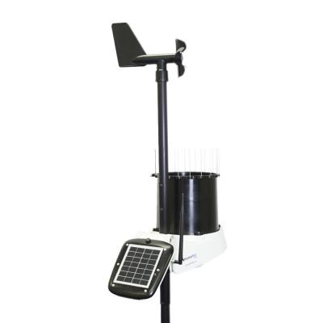
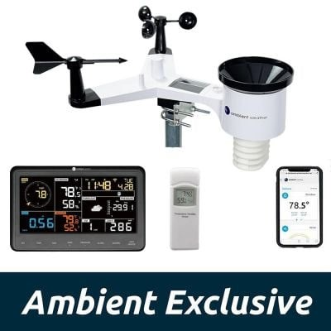
Inspiration
Browsing online at various home weathering systems allowed us to visualize how different they can be between each other.
It gave us inspiration into how we want to power on our system and the size it would take to design a low-cost power efficient system.
It also led to us finding faults in the existing systems on the market which allowed us to improve on our design that we hadn’t seen.

Slide 5

System Functional Requirements
Data Processing– the system must be able to record sensor readings and accurately translate the readings into weather conditions
Data Transmission– the home unit must be able to send its data through Wi-Fi so that the NYSDEC can access, store, and use it at their convenience
Precision– the system must be able to read, interpret, and record data from the sensors continuously to provide NYDEC the most precise set of data

Slide 6
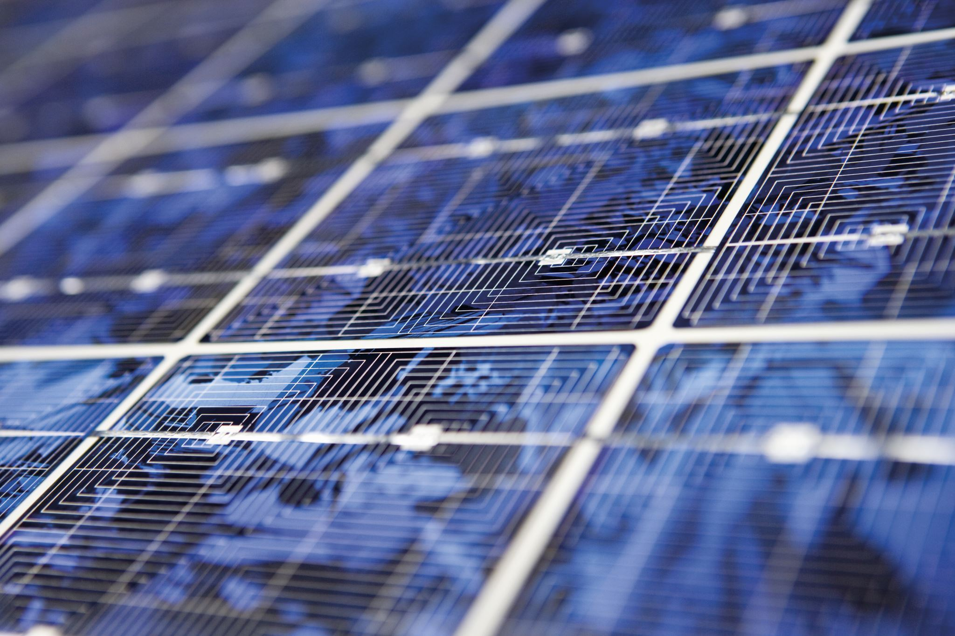
Subsystem Functional Requirements
Power Management – The power subsystem should manage and distribute power to meet other subsystem requirements, making sure that the supply is stable and reliable without overloading the other subsystems
Energy Storage – The power subsystem is going to store the excess energy from the solar panel in a battery for later use and to charge the battery
Reliability – Power system must minimize downtime and ensure that the rest of the weathering system will operate, even during harsh weather or home power outage

Slide 7

System Non- Functional Requirements
Durability – the field unit must be able to withstand harsh weather conditions over extended periods of time while ensuring the components remain protected and undamaged
Usability – the system should support ease of use for all homeowners, with a user-friendly UI to make the data easily accessible, and a simple installation/setup process to get the user started
Reliability – The users should be able to rely on the system to accurately supply weather information from the sensors on the field unit

Slide 8

Subsystem Non- Functional Requirements
Efficiency – The power subsystem should work with high efficiency, lowering energy loss and optimizing power usage
Availability – Power system should minimize downtime, maintain high availability, and ensures that the weathering system is always operational
Compatibility -Power system should be compatible with the components of the other subsystems and a wide range of sensors

Slide 9

System Design Constraints
Financial – There is a budget of $200. We are limited to a certain quality of components that can be used to build the home weathering system.
Weight – The weight of the system should be reasonable. If it is too light, then it can easily be damaged by strong wind or heavy rain. If it is too heavy then it could be harder to place the system in the correct location, and it can damage the surrounding area.
Material – The material that the system will be built out would cause some constraints. An example is that when picking the material to build the system out of, we have limited choices because we need to pick a material that would not rust so easily.

Slide 10
Subsystem Design Constraints
Battery Capacity - The battery type determines how much energy the subsystem can store and supply the power needed for the other subsystems.
Solar Panel – The type of solar panel will determine how much power we can draw from the sun that way the system can effectively run. The size of the panel can also constraint us when designing our casing.
Financial – Since there is a limit of $200 for the entire system, the budget for the power supply will be also be limited. A lower budget also means that there will be lower quality in components.

Slide 11
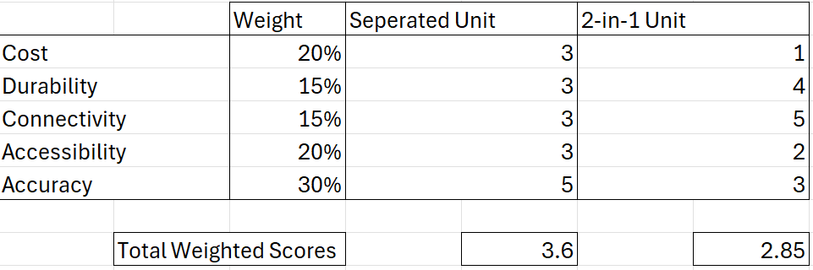
Decision Matrix
Our decision matrix is based on the following categories: Cost, Durability, Connectivity, Accessibility and Accuracy
Each category that was weighed was based on the idea of how the user or the NYSDEC would find the system whether it would be more efficient to use les inefficient.
After careful considering and collectively brainstorming, the decision matrix allowed us to continue our design knowing which version of the system would be the most efficient and effective.

Slide 12
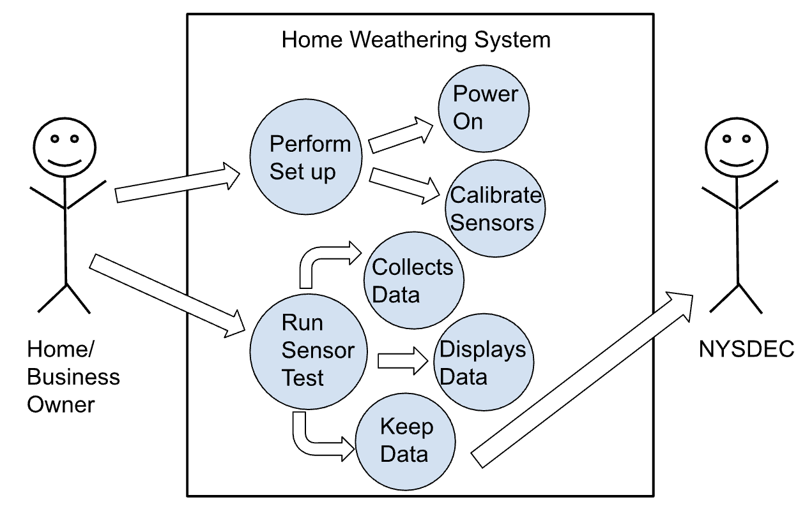
Use case Diagram

Slide 13
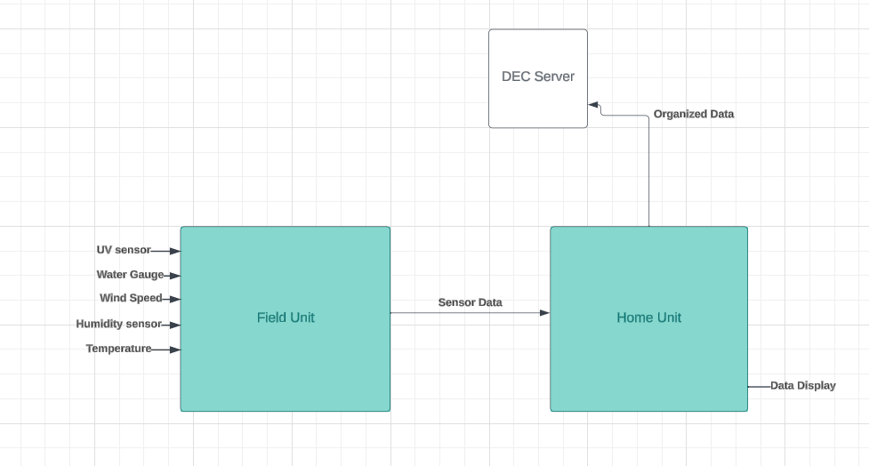
Data Flow Diagram

Slide 14
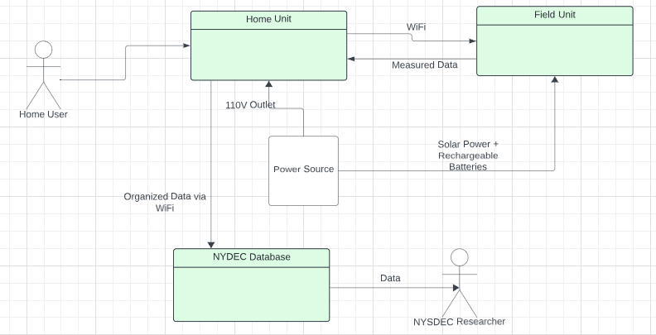
Design Overview & Justifications
The design comprises a Home Unit, Field Unit, Power Source, and NYSDEC Database, facilitating efficient communication between homeowners and research scientists
Its user-friendly interface and ease of installation distinguish it, with data storage in the NYSDEC database
Exploration of alternative designs, such as an All-in-one unit installable on user walls, revealed benefits such as reduced development costs for power sources and processing units, along with decreased installation expenses

Slide 15
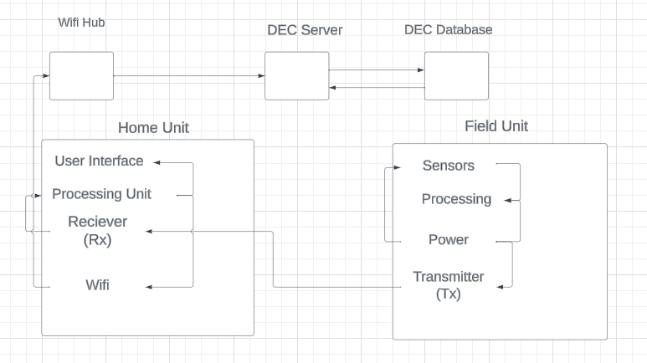
System Logical Design
The field unit will take in data from the sensors and process it to an extent, where it will then be sent via the transmitter to the home unit’s receiver
After it is received, the data will be sent to the CPU for processing, displayed for the user, and sent to the DEC via Wi-Fi
The home unit is where the bulk of the data processing will take place, as the components are better protected, and it is therefore safer to use a more reliable processor

Slide 16
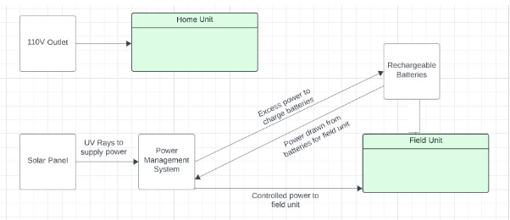
Subsystem Logical Design
The power system considers the system design, which consists of the Home and Field Unit
The Home Unit will be powered by a 110V Outlet while the Field Unit will use solar energy to power the system
The Field Unit power system consists of two parallel connected solar panels, a Power Management System Unit and a Micro controller

Slide 17
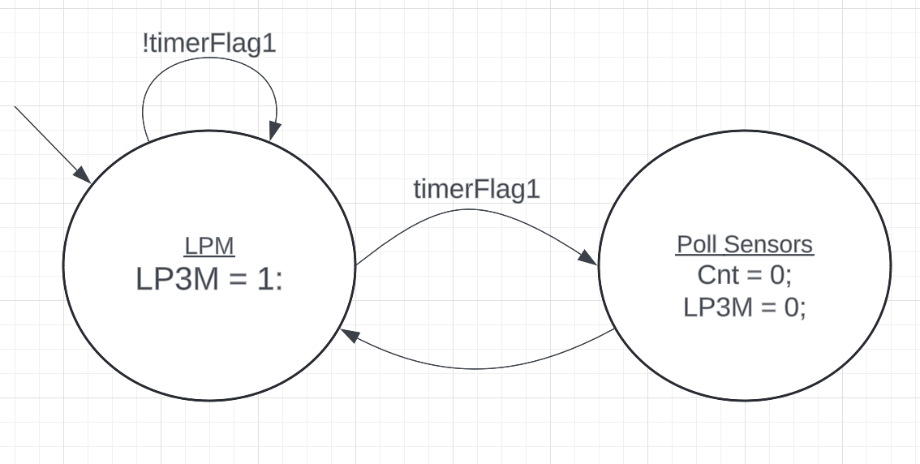
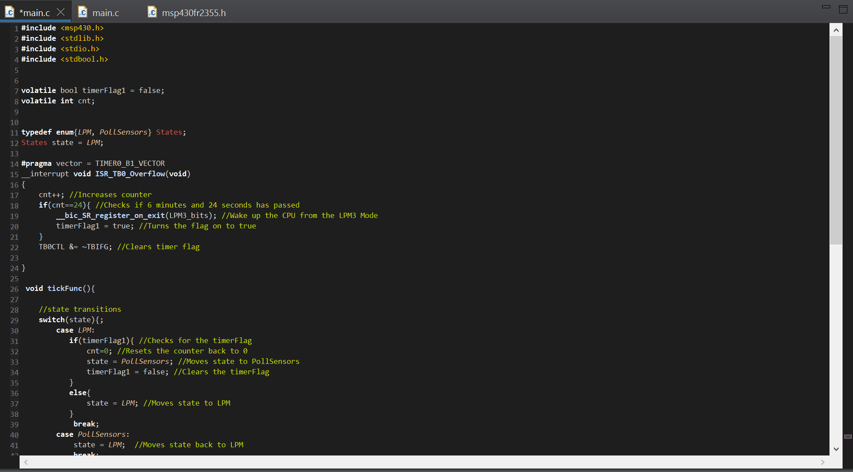
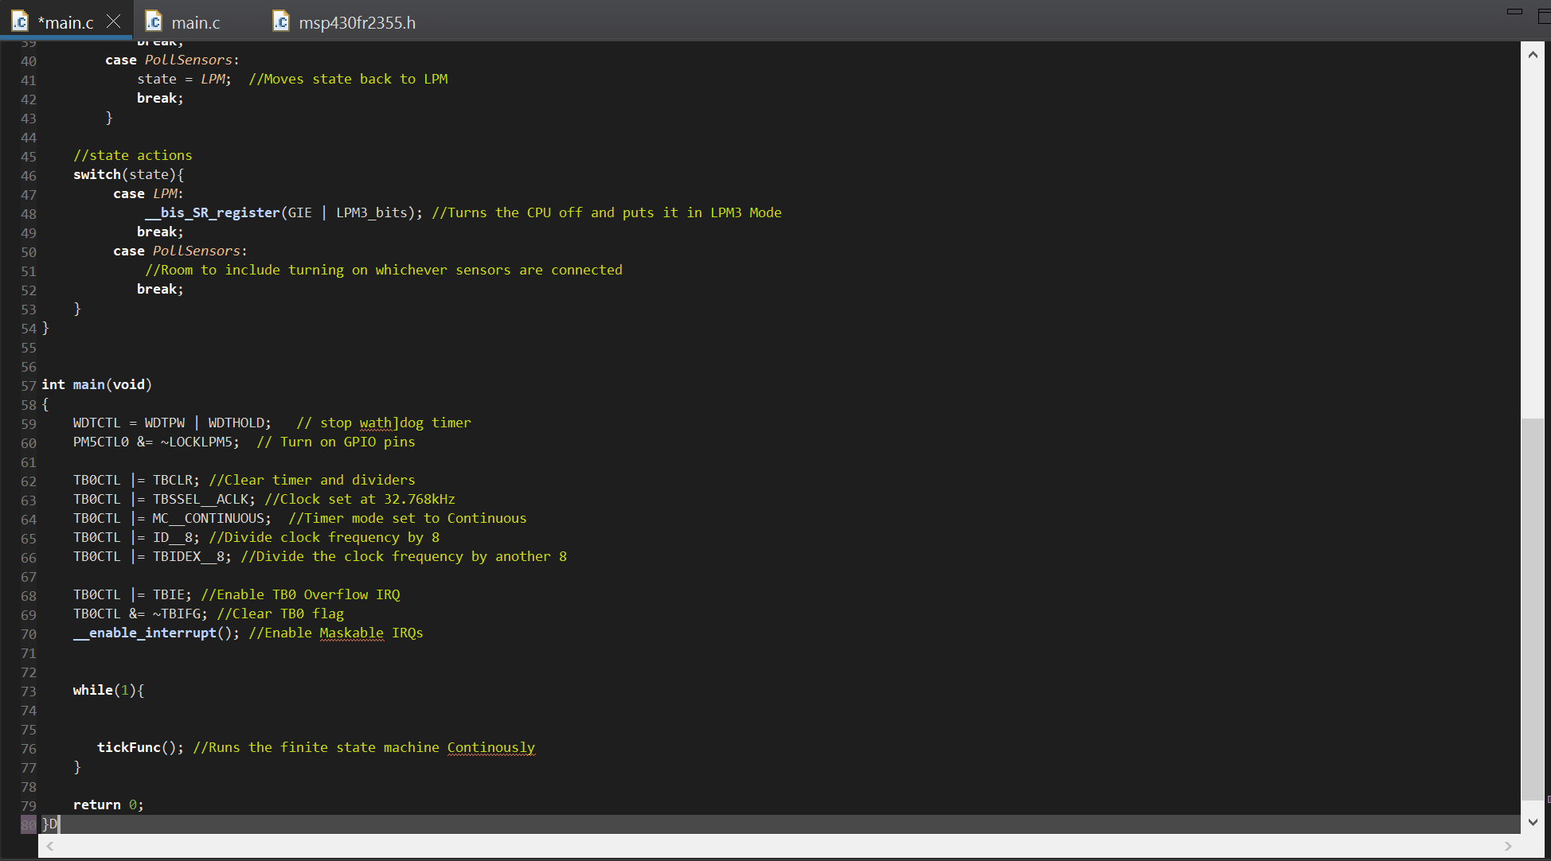
Programing/FSM
Using a Finite State Machine(FSM) allowed for efficient periodical cycling between the microcontroller and the power needed for the system.
Having the CPU enter a lower current consumption allowed for a longer lifespan of the system from a full charge or even just from the sun.
The implementation of the FSM onto the microcontroller was done via C code using Texas Instruments own code composer studio.
After entering the lower current consumption, the microcontroller drew about 1.5 μA of power. After waking up the CPU again it would draw about 350 μA.

Slide 18
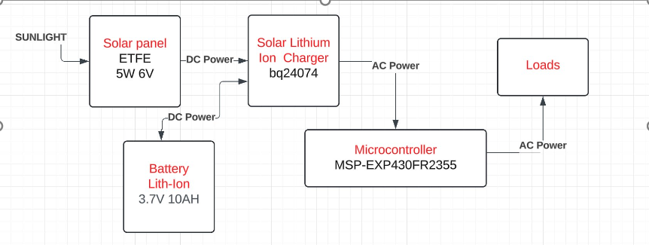
Subsystem Physical Design
The solar power unit is designed to harness renewable energy from the sun efficiently and sustainably
Consisting of photovoltaic solar panels, a charge controller, batteries for energy storage, and a micro controller to power the system on the cycles.

Slide 19
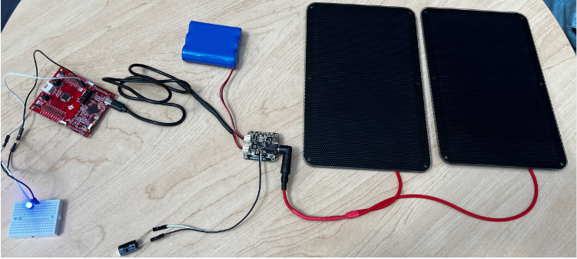
Physical Prototype

Slide 20
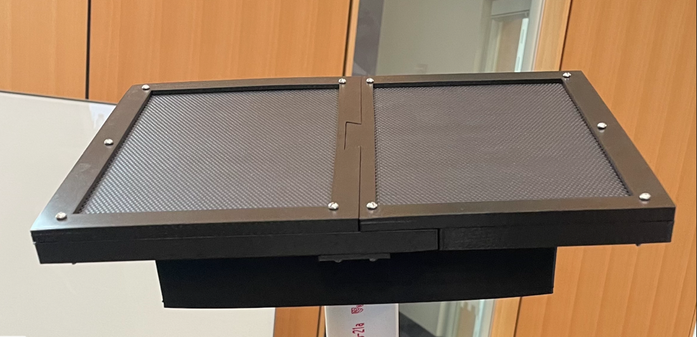
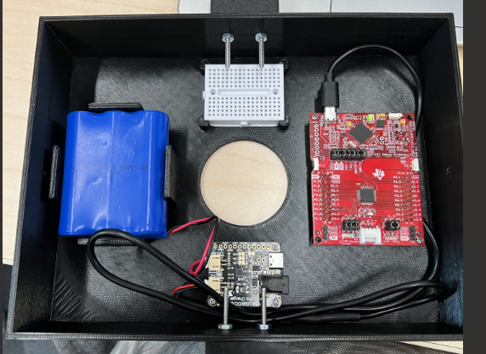
Final Physical Design with Casing

Slide 21
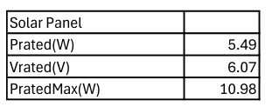
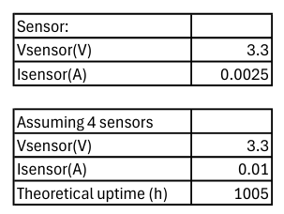
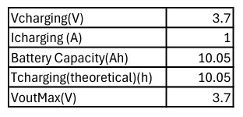
Subsystem Part Specs

Slide 22
Power Supply System Specifications
Vrated: 3.7V
Irated: 1A
Prated: 3.7W
Battery Capacity: 10Ah
Idle Power Consumption: 5.55uW

Slide 23

ANY QUESTIONS????

